Slide 1
Experts’ journey through WWII violences
A visualisation of the violences’ impact on the practice of expertise
DH Benelux – June 2016

Slide 2
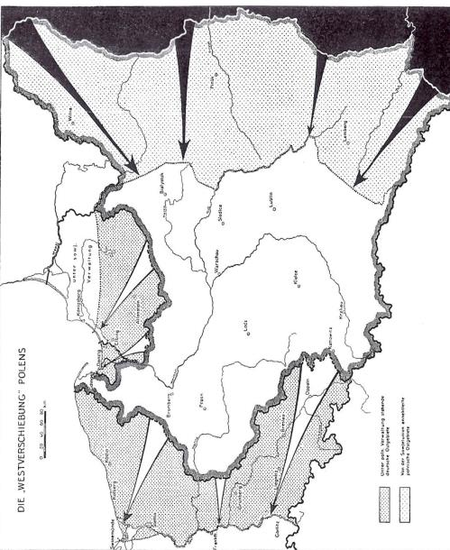
Polish and German expertise on Eastern Europe
Experts from
The German Council on Foreign Relations (DGAP - FRG)
The German Institute of Contemporary History (DIZ-GDR)
The Polish Institute on Foreign Affairs (PISM)

Slide 3
Visualisation of expertise?
Biographies
Mobility
Violence
Knowledge of Eastern Europe
+
Publications
Analyses of the East
Bilateral relations with East Europe
=
Typology of expertise
Sovietology / Eastern Studies / Recognition

Slide 4
Biographies
Biographies
Publications
Typology of expertise
Journalism
State servant
Military service
Academia
Professional path

Slide 5
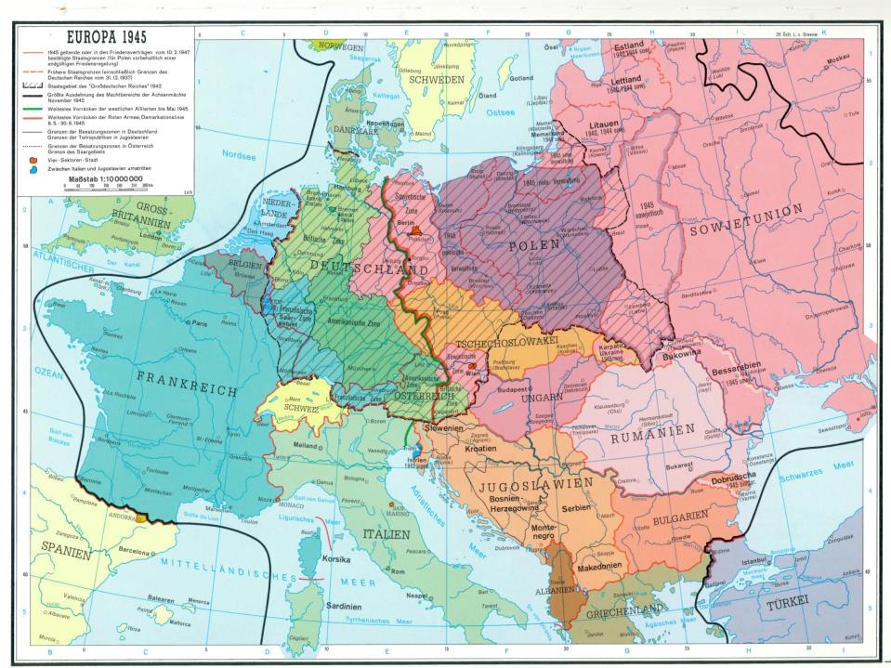
Mobility

Slide 6
Mobility
Biographies
Mobility
Publications
Typology of expertise

Slide 7
Mobility
Biographies
Mobility
Publications
Typology of expertise

Slide 8
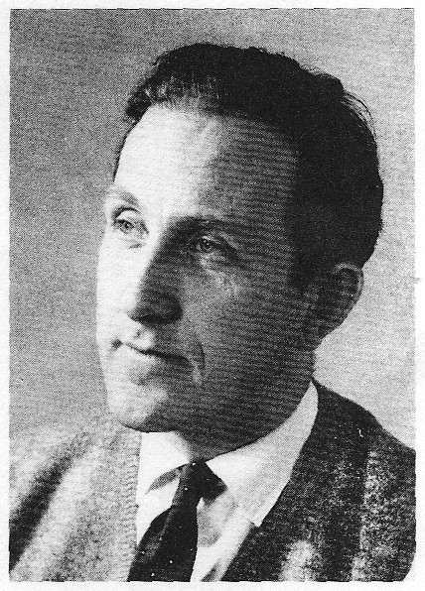
Mobility
Biographies
Mobility
Violence
Publications
Typology of expertise
Wilhelm Cornides
(1920-1966)

Slide 9
Carrier and war
Biographies
Mobility
Violence
Publications
Typology of expertise
Wilhelm Cornides
(1920-1966)

Slide 10
Carrier and war
Biographies
Publications
Typology of expertise
“Active” violence
Suffering from violence
POW
Witnessing violence
Experience of
violence

Slide 11
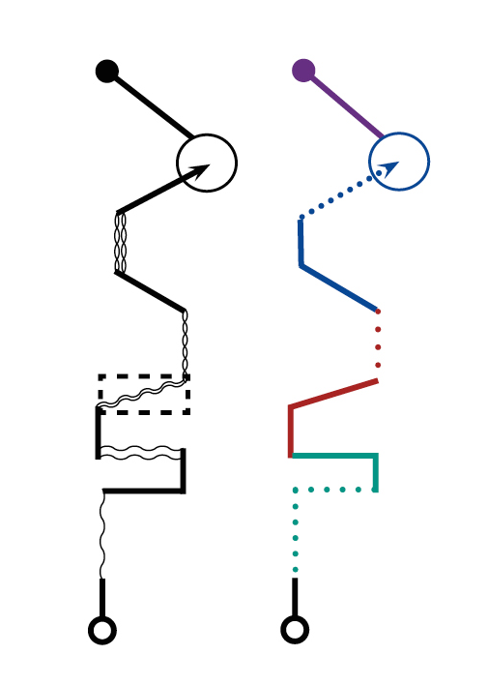
Carrier and war
Biographies
Publications
Typology of expertise
Experience of
violence
+
professional curiculum
=
Biographical path

Slide 12
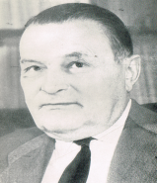
Carrier and war
Biographies
Mobility
Violence
Publications
Typology of expertise
Transnational comparison:
Stanisław Zabiełło

Slide 13
Carrier and war
Biographies
Mobility
Violence
Publications
Typology of expertise
Transnational comparison: Stanisław Zabiełło and Wilhelm Cornides

Slide 14
Carrier and war
Biographies
Mobility
Violence
Publications
Typology of expertise
Differences in mobility
and war impact:
Hans-Adolf Jacobsen (*1925)
and
Ulrich Scheuner (1903-1981)

Slide 15
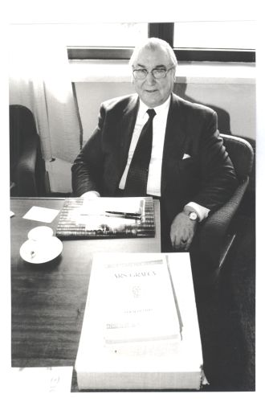
Carrier and war
Biographies
Mobility
Violence
Publications
Typology of expertise
Missing data: Boris Meissner (1915-2003)

Slide 16
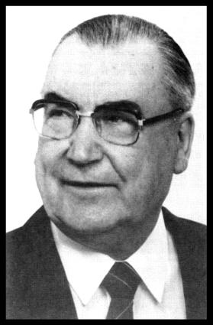
Carrier and war
Biographies
Mobility
Violence
Publications
Typology of expertise
Missing data:
Boris Meissner
(1915-2003)

Slide 17
Conceptions of the East
Biographies
Publications
Analyses of the East
Bilateral relations (with the East)
Typology of expertise
Other case of missing data:
Dietrich Loeber

Slide 18
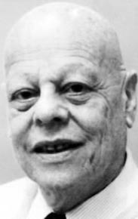
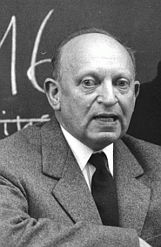
Experience and knowledge
Biographies
Publications
Typology of expertise
Стефан Дёрнберг
Similar start, different evolution: Richard Löwenthal – Stefan Doernberg)
Paul Sering

Slide 19
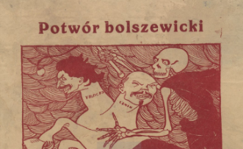
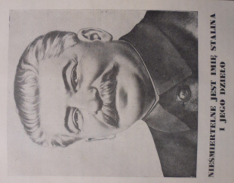
Knowledge of the East
Biographies
↓
Publications
Typology of expertise
Polish anti-Bolshevik poster printed during the Polish-Soviet war in 1920

Slide 20
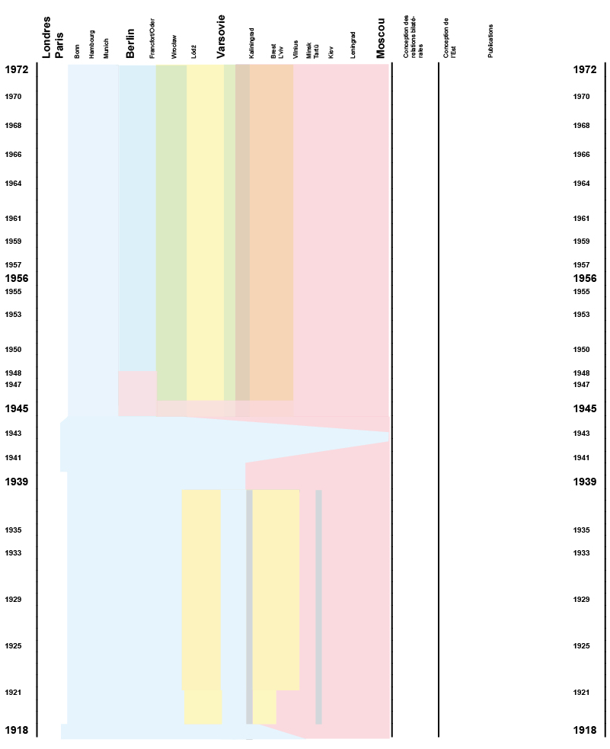
Knowledge of
the East
Biographies
Publications
Typology of expertise

Slide 21
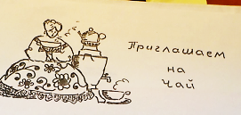
+
Knowledge of the East
Biographies
Publications
Analyses of the East
Bilateral relations
(with the East)
Typology of expertise
=

Slide 22
Conceptions of the East
Biographies
Publications
Analyses of the East
Bilateral relations (with the East)
Typology of expertise
Profile of continuity:
Boris Meissner

Slide 23
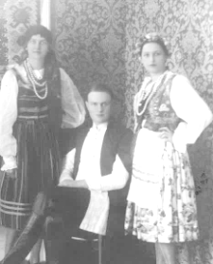
Conceptions of the East
Biographies
Publications
Typology of expertise
Profile of evolution
before
and after the war:
Stanislaw Zabiello

Slide 24
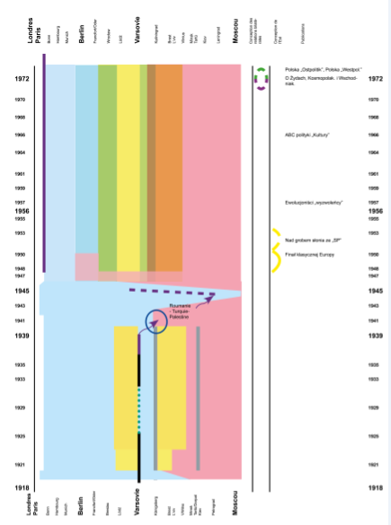
Conceptions of the East
Biographies
Publications
Analyses of the East
Bilateral relations (with the East)
Typology of expertise
Profile of post-war
evolution:
Juliusz Mieroszewski

Slide 25
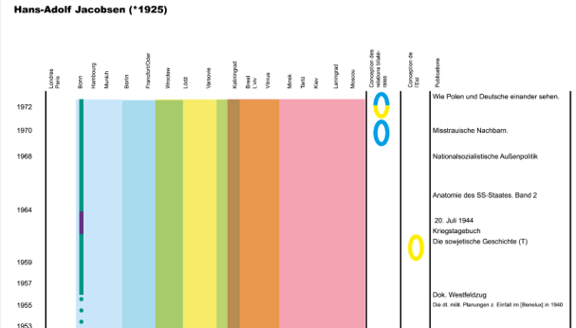
Conceptions of the East
Biographies
Publications
Typology of expertise
Biographical path
+ publications
= profile

Slide 26
Conceptions of the East
Biographies
Publications
Typology of expertise
Biographical path
+ publications
= profile

Slide 27
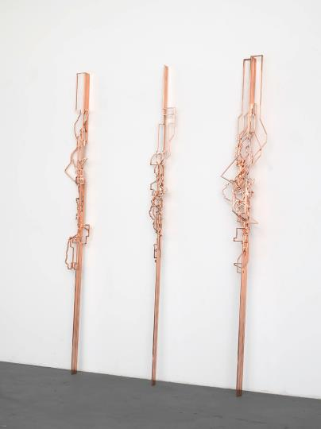
Output : Typology of expertise
Biographies
Publications
Typology of expertise
Sovietology
Eastern Studies
Recognition
Alicja Kwade – Time zones
Alicja Kwade – Time zones

Slide 28
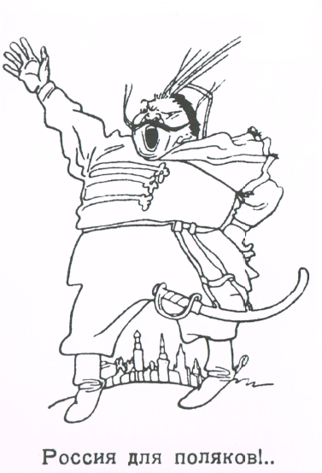
Thank you!
Russia to the Poles!

